Slide 1
FACULTY & STAFF
MENTAL HEALTH
RESOURCES

Slide 2
FACULTY & STAFF
MENTAL HEALTH
RESOURCES
Click Play for
Introduction

Slide 3
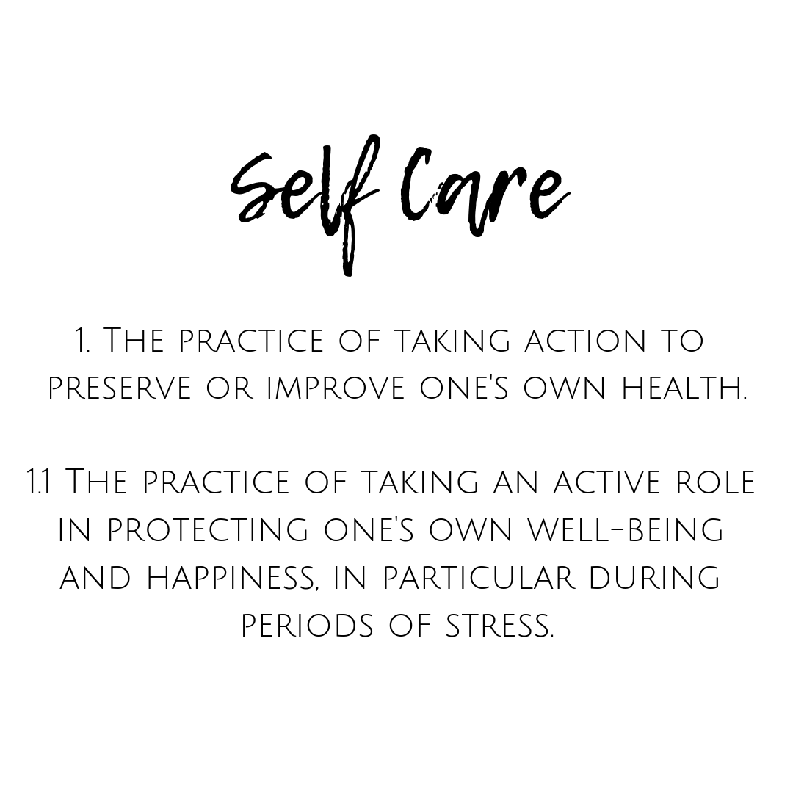
Definition
self-care
/selfˈker/
noun
*Oxford English Dictionary. Oxford: Oxford University Press

Slide 4
Why is self-care so important?
It is impossible to pour from an empty cup.
(It is important to take care of yourself first, so you have something to give).
Notes:
Because….so…take care of yourself first.

Slide 5
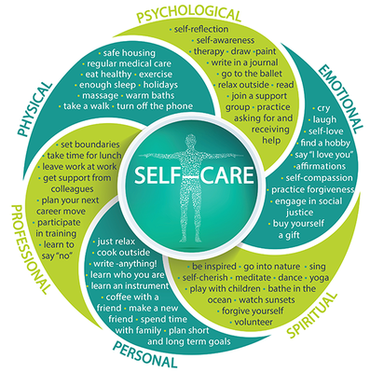
Types of Self-Care
&
Examples

Slide 6
Quick Start Ideas for Self-Care
Get outside (fresh air and sunshine)
Get moving (walking, biking, hiking, etc.)
Meditation, journaling, mindfulness
Keep a routine (normal office hours, getting ready for your day, etc.)
Stay connected (phone, virtually, physically distanced/masked, etc.)
Eat healthy, stay hydrated
Sleep; rest & relaxation
Focus on what you can do
Stay informed, but not overloaded (take a break from media/social media)
Advocate for your health/medical needs
Ask for help when you feel overwhelmed
Know your support network (where you can get help from)

Slide 7
Sources of Support
CAPS offers an online database of local providers: uark.miresource.com. MiResource is a resource offered to the campus community; it is a search engine of mental health providers.
Faculty and staff can also access services through the Employee Assistance Program. Appointments can be made by calling 479-973-9072 or 800-542-6021. (The Arkansas Employee Assistance Program is also available to graduate assistants and their families).
United Health Member Assistance Program (MAP): This is a new program through UMR that is an option for all benefits-eligible employees working within the UA System office and campuses. Information on accessing the program is available on the UA System website.
Faculty and staff are encouraged to view CAPS self-care webinars and workshops, as they offer excellent strategies to cope with common mental health concerns.
Faculty and staff can also access psychiatric care through Pat Walker Health Center Primary Care Clinic. Psychiatry appointments can be scheduled by calling 479-575-4451.
Resources to help support students.
Click on links

Slide 8
Your Support Network
YOU
Social Support (Family & Friends)
The University
Community Support (Counselors, MDs, Internet, Apps)
Co-Workers & Supervisors
OEOC (to report discrimination or request accommodations)
Human Resources
IT (Information Technology Services)
Dean Of Students Office
Click on Links

Slide 9
REMEMBER:
It’s okay to take care of yourself.
It’s okay to set boundaries.
It’s okay to rest.
It’s okay to ask for help.
Breathe.

Slide 10
Additional Websites and Apps
CAPS Instagram
https://www.instagram.com/uofacaps/
Links to resources: https://linktr.ee/uofacaps
Psychology Today
https://www.psychologytoday.com/us
Man Therapy
https://mantherapy.org/
Helpguide
https://www.helpguide.org/
Veterans Crisis Line
https://www.veteranscrisisline.net/
UCLA Health (free guided meditations)
https://www.uclahealth.org/marc/mindful-meditations
https://urec.uark.edu/wellness/certificate.php
(Learn more about
UREC’s UARK Wellness department and the certificate program available to faculty & staff).
Headspace (Free trial; monthly Subscription fees)
https://www.headspace.com/
Calm (Free trial; Annual subscription fee)
https://www.calm.com/
DBT Diary Card & Skills Coach
https://www.diarycard.net/
Pacifica (Free mindfulness and meditation App)
https://www.sanvello.com/
Find trails near you:
https://www.traillink.com/
My 3 App
https://my3app.org/#stay-connected
Buddhify (Purchase App fee & annual fee)
https://buddhify.com/
Stop, Breathe & Think (Free; or premium w/monthly fee)
https://my.life/
Click on links
THANK
YOU!

